Slide 1
Twitter Dataset Based Sentimental Analysis with Machine Learning Approach
Submitted in the partial fulfillment for the award of the degree of
BACHELOR OF ENGINEERING
IN
Artificial intelligence and Machine Learning
Submitted by:
Ajay Kethuri - 20BCS6585
Bharath Vupputuri – 20BCS6586
Vignesh Endluru – 20BCS6891
Akshay Kumar Koyyada – 20BCS6369
Under the Supervision of:
Dr. Ranjan Walia
Department of AIT-CSE
DISCOVER . LEARN . EMPOWER

Slide 2
Outline
Introduction to Project
Problem Formulation
Objectives of the work
Methodology used
Results and Outputs
Conclusion
Future Scope
References

Slide 3


Introduction to Project
Sentiment Analysis which is done under Natural
Language Processing that identifies the emotion
of the text that a particular person posted.
Nowadays, it is done primarily through blog
postings, internet forums, websites that offer
product reviews, social media, etc
Consumers heavily rely on usergenerated content
from the internet when making decisions.

Slide 4
Introduction to Project
Techniques for retrieving information from text typically concentrate on processing, looking up, or interpreting the factual data that is already there.
Sentiment Analysis's fundamental components—opinions, sentiments, assessments, attitudes, and emotions—are primarily represented by these contents (SA).
Sentiment analysis is a major approach for classifying the given text into positive and negative in Natural Language Processing ( NLP ).

Slide 5
Problem Formulation
Problem statement of the project is to analyze the machine learning models for sentiment analysis for given data.
How Natural Language Processing techniques are used to pre-process data?

Slide 6
Objectives of the Work
The primary objective of the project is to Create a model for classifying the tweet into respective sentiment.
Creating a new dataset of latest tweets on twitter consisting 31961 of them.
Data collected is loaded into various machine learning models.
After training and testing, find its accuracy accordingly.
Make sure the accuracy is above 80%.
Data visualize on the model.

Slide 7
Methodology used
In this study there are primarily 5 stages to it. Every stage is so vital and helps in building the efficient model.
Following below are the steps:
A. Data Collection
B. Data Preprocessing
C. Feature Selection
D. Model Selection
E. Model Evaluation

Slide 8

Natural Language Processing(NLP)
Natural Language Processing isa machine learning
technology that gives computers the ability to
interpret, manipulate, and comprehend
human language
The goal of NLP is to develop algorithms that can
process and interpret human language in a way
that computers can understand, so that they can
perform tasks such as translation ,chatbots etc.

Slide 9
Classifiers Used
Logistic Regression
Support Vector Machine(SVM)
Multinomial Navi Bayes
Random Forest
K- Nearest Neighbor(KNN)
Linear Discriminant Analysis (LDA)

Slide 10
Logistic regression is used to calculate or predict the probability of a binary (yes/no) event occurring.
Support vector machine(SVM) is a particular linear classifiers which are based on the margin maximization principle.
The Multinomial Naive Bayes algorithm is a Bayesian learning approach popular in Natural Language Processing (NLP). It calculates each tag's likelihood for a given sample and outputs the tag with the greatest chance.

Slide 11
A random forest is simply a collection of decision trees whose results are aggregated into one final result.
KNN is a non-parametric, supervised learning classifier, which uses proximity to make classifications or predictions about the grouping of an individual data point.
Linear Discriminant Analysis (LDA) is a supervised algorithm that aims to find the linear discriminants to represent the axes that maximize separation between different classes of data

Slide 12
Results and Outputs
Various accuracies are achieved by different machine learning models as follows:
Logistic Regression: 94.41
Support Vector Machine: 94.50
Multinomial Naïve Bayes: 93.69
Random Forest: 94.05
K Nearest Neighbor: 93.79
Linear Discriminant Analysis: 93.99
By above accuracies, though the difference is negligible, most suited classifier for the given data of tweets is Support Vector Machine.

Slide 13
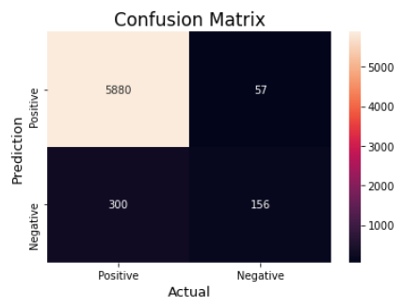
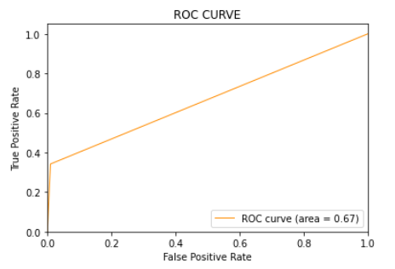
LOGISTIC REGRESSION

Slide 14

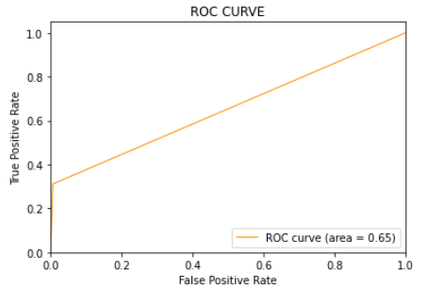
SVM

Slide 15
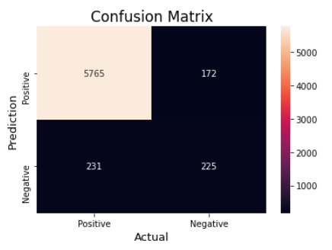
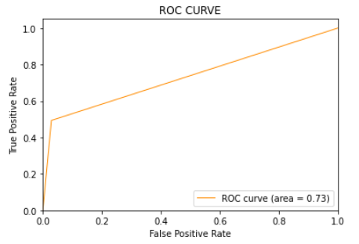
MULTINOMIAL NAÏVE BAYES

Slide 16
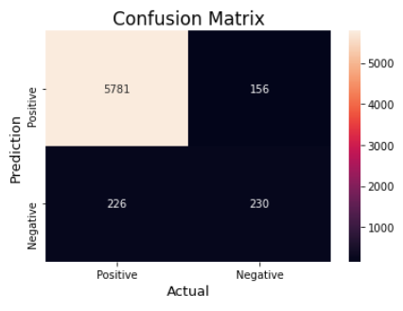
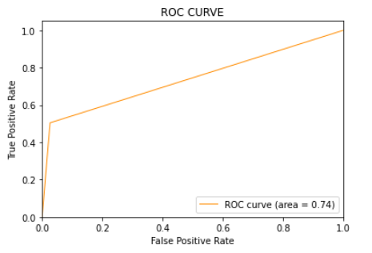
RANDOM FOREST

Slide 17

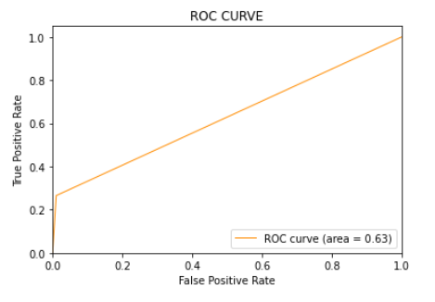
K NEAREST NEIGHBOR

Slide 18
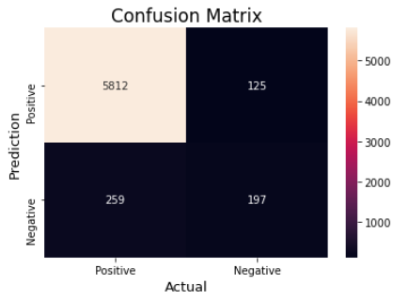
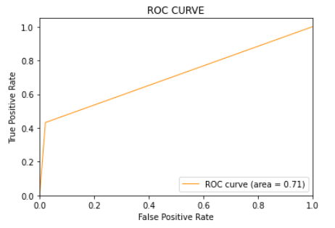
LINEAR DISCRIMINANT ANALYSIS

Slide 19
Conclusion
In this paper, we demonstrated how the twitter sentiment analysis is done using different machine learning models and Natural Language Processing (NLP).
We performed training and testing on the data and achieved a good accuracy of 94 percentage.

Slide 20
Future Scope
In the future this can be used or modified or enhanced for the purpose of extracting the twitter trends on a particular topic.
With this model we can know how twitter people are reacting on a specific topic.
This can be also helpful for further other classification techniques or deep learning or neural networks.

Slide 21
References
[1]. Zahratu Sabrina explained what are the different approaches for sentiment analysis, 2023.
[2]. 2023, Shamsuddeen Hassan Muhammad implemented sentiment analysis for various languages in Africa.
[3]. 2023, Vedurumudi Priyanka used ensembling technique, which combines various classifiers, in order to improve the accuracy for the dataset taken from Kaggle.
[4]. 2023 Imane Lasri used sentiment analysis for Moroccan public universities from twitter using big data technologies.
[5]. 2022, Yili Wang used a few other approaches for sentiment analysis which includes probabilistic classifier, Linear classifier, rule-based classifier, hybrid approach and other approaches.
[6]. 2022, Masoud AminiMotlagh collected data, pre- processed it, detected and classified accordingly. This research paper included some of the machine learning techniques like KNN, SVM, NAÏVE BAYES and Bagging.
[7]. 2022, Astha Modi analyzed how different techniques like LSTM, Naïve bayes, decision tree and SVM are working. Accuracies are also recorded and future scopes of every technique also mentioned in it.

Slide 22
References
[8]. 2019, Abdul Rasool took a case study on twitter sentiment analysis for apparel brands. Firstly, data is pre-processed and cleaned. Two brands are taken namely Nike and Adidas.
[9]. 2019, Faizan followed a certain procedure which includes data collection, data pre-processing, feature extraction, model selection and model evaluation. API available for twitter is used to collect data from twitter.
[10]. 2019, Abdullah Alsaeedi also used classification techniques that are Naïve bayes, Maximum Entropy
and Support Vector Machine. Differentiation of document level and sentence level sentiment analysis also addressed in this research paper.
[11]. Pang, B., & Lee, L. (2019). Opinion mining and sentiment analysis. Foundations and Trends® in Information Retrieval, 2(1-2), 1-135.
[12]. Cambria, E., & Hussain, A. (2019). Sentic computing: Techniques, tools, and applications. Springer.
[13]. Mohammad, S. M., & Turney, P. D. (2019). Crowdsourcing a word–emotion association lexicon. Computational Intelligence, 29(3), 436-465.
[14]. Liu, B. (2019). Sentiment analysis and opinion mining. Morgan & Claypool Publishers.

Slide 23
References
[15]. Thelwall, M., Buckley, K., & Paltoglou, G. (2018). Sentiment in Twitter events. Journal of the Association for Information Science and Technology, 63(1), 119-132.
[16]. Kouloumpis, E., Wilson, T., & Moore, J. D. (2018). Twitter sentiment analysis: The good the bad and the OMG!. ICWSM, 11(538-541), 164-167.
[17]. Pak, A., & Paroubek, P. (2018). Twitter as a corpus for sentiment analysis and opinion mining. Proceedings of the 7th conference on International Language Resources and Evaluation (LREC'10).
[18]. Zhang, L., & Wu, D. (2017). A comprehensive survey on sentiment analysis of social media. Advances in Mechanical Engineering, 11(8), 1687814019867565.
[19]. Agarwal, A., Xie, B., Vovsha, I., Rambow, O., & Passonneau, R. (2017). Sentiment analysis of Twitter data. Proceedings of the Workshop on Languages in Social Media, 30-38.
[20]. Medhat, W., Hassan, A., & Korashy, H. (2017). Sentiment analysis algorithms and applications: A survey. Ain Shams Engineering Journal, 5(4), 1093-1113.

